Slide 1
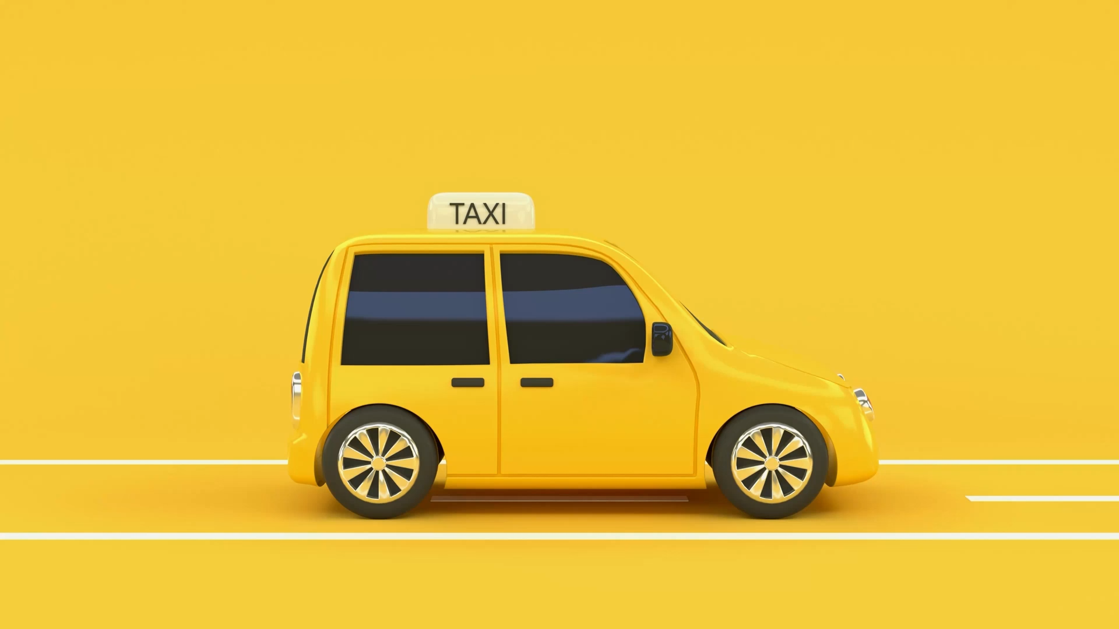
TAXI DATA ANALYSIS AND PREDICTION
TEAM
Kavya Vempati
Leela Kali Manasa Mandadi
Ajith Narasimha
Krishna Sahitya Devineni

Slide 2




BUSINESS PROBLEM
Understanding various patterns in NYC taxis is crucial for optimizing transportation services and meeting the diverse needs of the city's populace. It allows in ensuring taxis are available when and where they are most needed, identifying which locations have tipping possibility

Slide 3




DATA COLLECTION
TAXI DATA – NYC Taxi & Limousine Commission
TLC Trip Record Data - TLC (nyc.gov)
Demographics & Transportation Information
Census Bureau Data
Weather Information
Сurrent weather and forecast - OpenWeatherMap
Business Operations in NYC
Legally Operating Businesses | NYC Open Data (cityofnewyork.us)

Slide 4
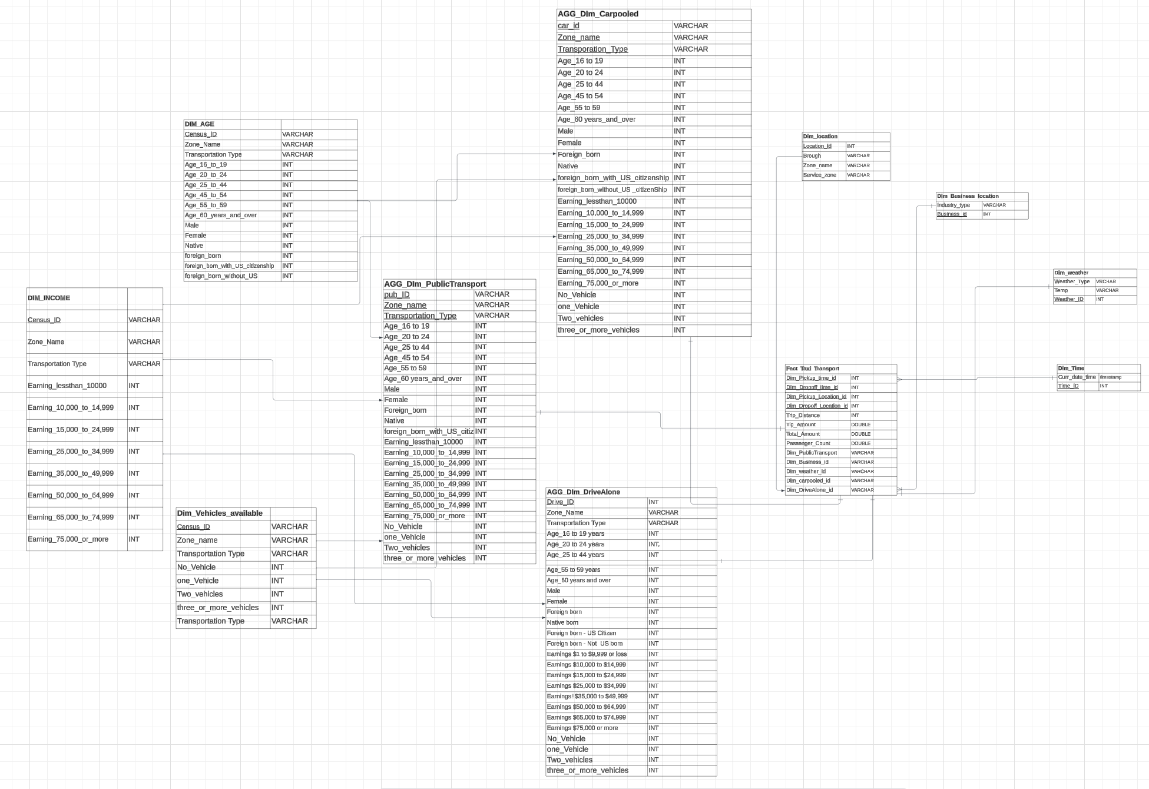
DATA WAREHOUSING

Slide 5
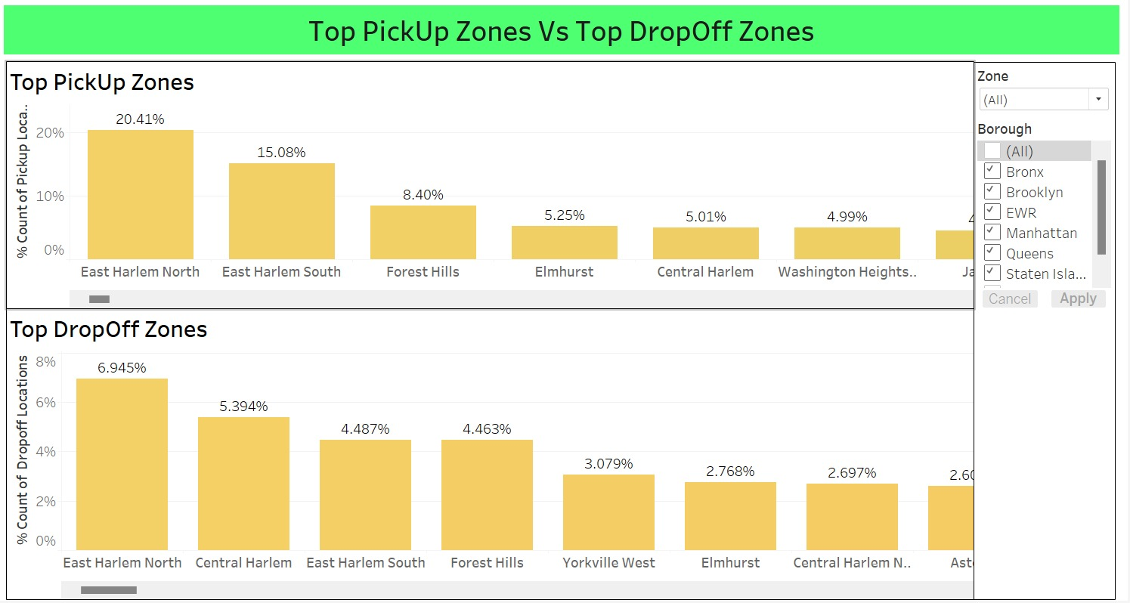
DATA VISUALIZATION
This dashboard presents a clear view of the prime locations where taxi pickups and drop-offs predominantly occur.
By prioritizing these key zones, taxi owners can strategically position their fleet to maximize the influx of requests.
Concentrating efforts on these high-traffic areas holds the potential to significantly increase taxi demand and optimize operational efficiency, ensuring a more responsive and lucrative service within the most sought-after areas.

Slide 6
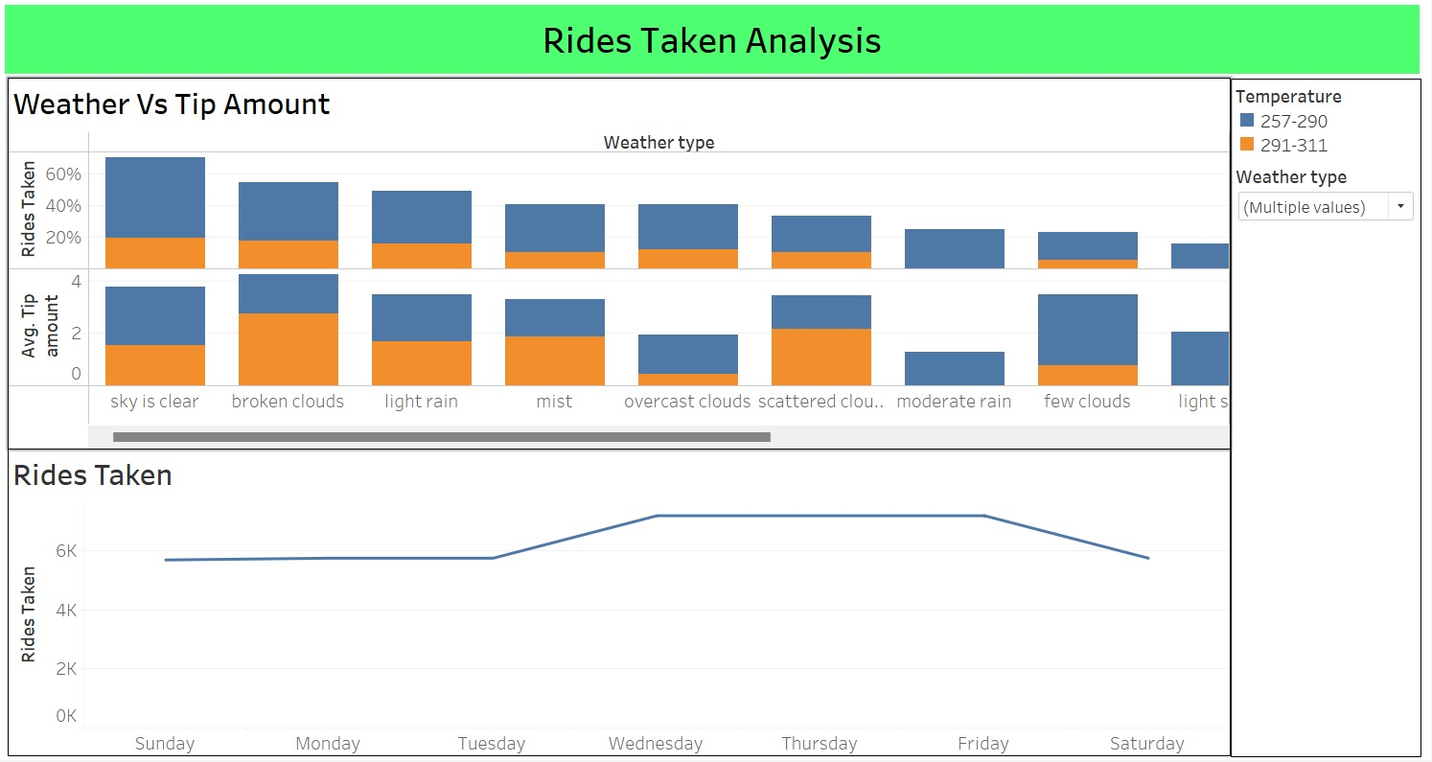
DATA VISUALIZATION
Tips tend to increase during cloudy weather, while clearer skies correspond to a higher frequency of rides.
Conversely, the fewest rides occur during snowy, hazy, and foggy weather conditions
Ride demand peaks on Wednesday, Thursday, and Friday, experiencing a noticeable decline on Saturdays.

Slide 7
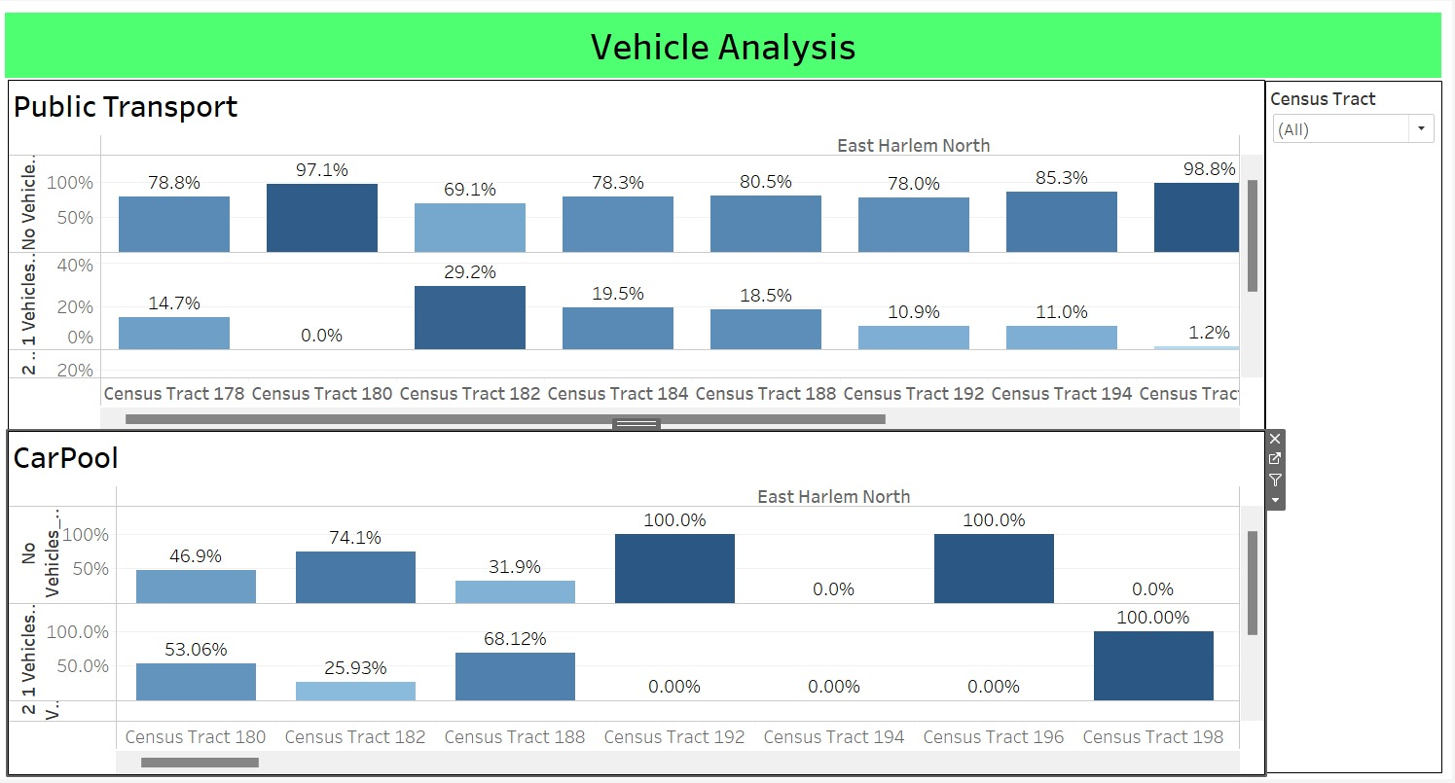
DATA VISUALIZATION
Identifies specific census tract areas to prioritize for increased ride opportunities for taxi drivers, considering the population using public transport and carpool options based on vehicle ownership within those locations.

Slide 8
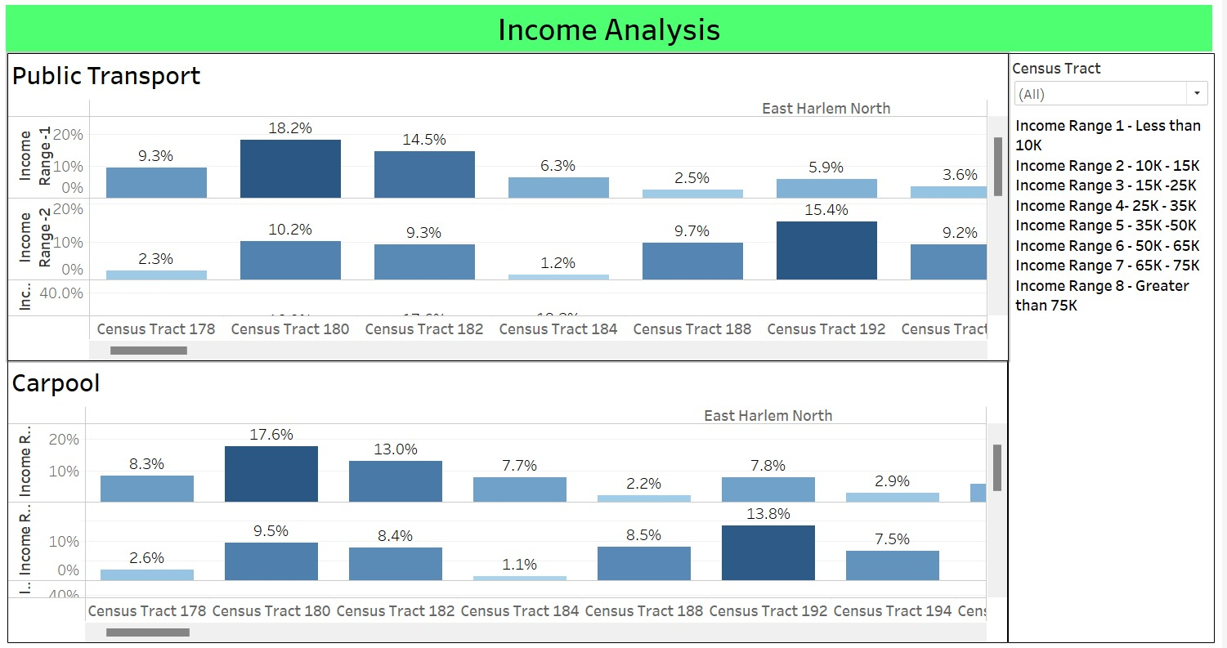
DATA VISUALIZATION
Pinpoints targeted census tract areas to optimize ride opportunities for taxi drivers, taking into account the population utilizing public transport and carpool options, while considering their income ranges within those specific locations.

Slide 9
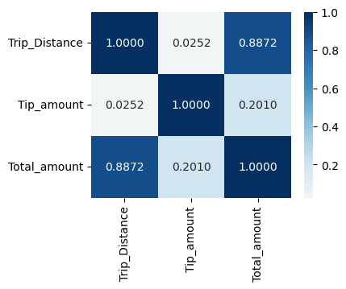
DATA MODELLING
Project Phases: Data Ingestion and Cleansing , Feature Engineering and Selection, Machine Learning Model Development
Feature Engineering
Datetime Columns Processing
Conversion of DOTimestamp and PUTimestamp to datetime format.
Extraction of new features: 'PU_weekday_num', 'PU_month', 'PU_pickup_hour', 'DO_weekday_num', 'DO_month', 'DO_pickup_hour’.
Machine Learning & Model Development
Utilized Supervised Regression Models
Linear Regression
Gradient Boosting
Evaluation Metrics: RMSE, r2
Feature Selection: Omitted 'total_amount' due to high correlation with 'trip_distance'

Slide 10
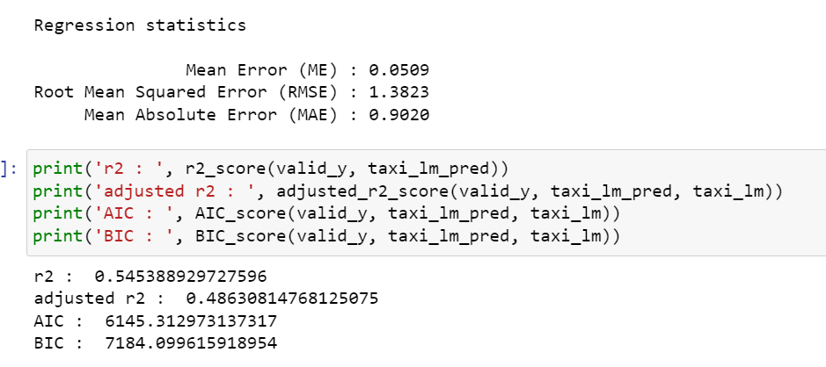
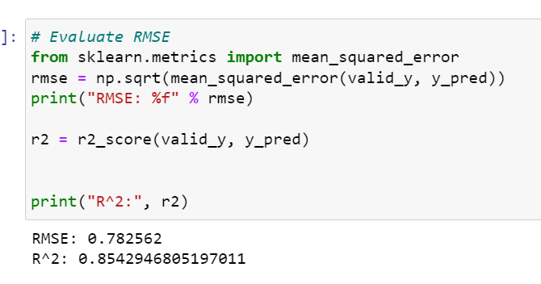
DATA MODELLING
Linear Regression Model
Predictive tool for tip estimation in taxi rides.
Based on relationships between input features and tip amounts.
Empowered drivers with insights for better planning and optimization.
Evaluated using RMSE, r2 for accuracy assessment
Gradient Boosting Regressor Model
Operational Principles:
Ensemble method combining multiple decision trees.
Focuses on refining predictions by minimizing errors iteratively.
Role in Project:
Complements Linear Regression in capturing complex relationships.
Leveraged historical taxi data for nuanced and precise estimations.
Evaluated using RMSE, r2 for accuracy validation.

Slide 11
LEARNINGS
.
Design for scalability to accommodate growing data volumes and developed solutions to address complexities in merging diverse datasets with varying formats.
Continuously monitor and optimize the warehouse for query performance and data retrieval.
Regularly revisit and refine data models and processes based on feedback and changing requirements.
Ensure data consistency and same granularity across sources to maintain integrity and reliability.
FUTURE RECOMMENDATIONS
Explore geospatial analytics to understand taxi movement patterns concerning demographics, weather conditions, and public transportation availability. This could uncover valuable insights about where and when taxis are most in demand.
Explore avenues for even deeper integration of additional relevant datasets. Consider incorporating socioeconomic data, traffic patterns, or events happening in the city to provide a more comprehensive understanding of taxi usage and its correlation with various factors.

Slide 12

THANK YOU !!
&
QUESTIONS??

